Slide 1


DIMY Protocol An Explanation
COMP4337 Assignment
By Roark Menezes (z5116870)

Slide 2


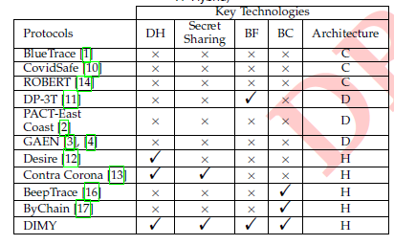
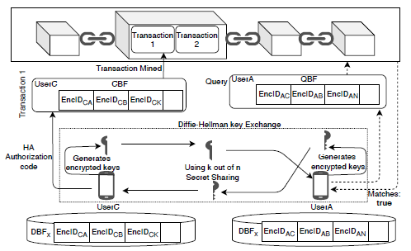
What is DIMY?
New type of contact tracing protocol
Uses a “hybrid” architecture
Makes use of concepts such as
Diffie-Hellman key exchange (with elliptic curves)
Shamir Secret Sharing
Bloom Filters
Blockchain
Figure 1: Comparison of key protocols in contact tracing space
Figure 2: Basic Protocol Architecture

Slide 3
Components of the DIMY Protocol
Generating Identifiers
Advertising Identifiers
Storing Encounter Information
Uploading Encounter Information
Contact Verification process

Slide 4
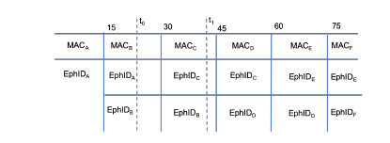
Generating and Advertising Identifiers
Ephemeral ID generated
Shamir Secret Sharing used to split and share ID
Reconstruction of the secret (can only be done after at least k out of n broadcasted shares received)
Encounter ID generated
Transmit 2 Ephemeral IDs to solve issue of “address carry over”
Why use ECDH? Why use SSS?
Figure 3: How BLE messages are advertised

Slide 5
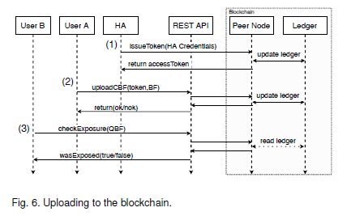
Storing, Uploading and Verifying Encounter Information
Encounter IDs encoded (stored) in Bloom Filters and then deleted
WHY USE BFs?
DBF, CBF, QBF
Hyperledger Blockchain used (with smart contracts)
Issue access tokens
Processing CBF
Processing QBF
REST APIs
WHY USE BLOCKCHAIN?
Figure 4: Uploading to Blockchain

Slide 6
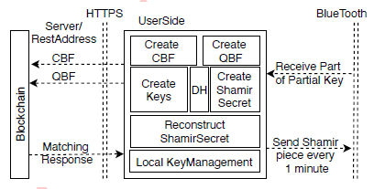
Conclusion
Combines concepts of ECDH, bloom filters, SSS and blockchain technology to create a contact tracing protocol that works efficiently, anonymously and securely.
Hybrid approach means user side does calculations while server does risk analysis.
Figure 5: DIMY Information Flow

